Slide 1
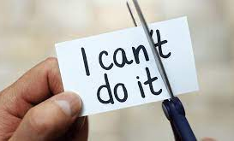
Chapter 7
Looking to the Future: Goals, Optimism, and Hope

Slide 2
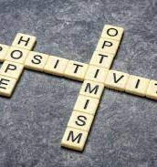
What are positive expectancies?
Positive expectancies: Beliefs that the future is likely to be positive.
Major types covered in the chapter:
  Optimism
  Hope
Both concern the attainment of goals.

Slide 3
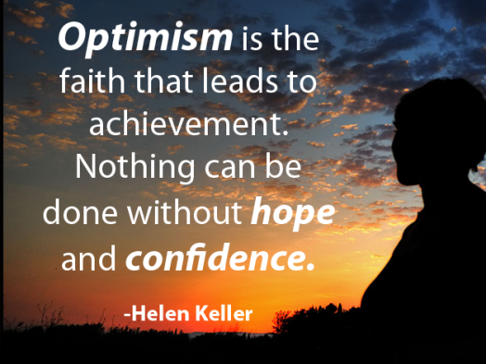

Slide 4


Goals
Goals: Desired outcomes.
Goals have implications for our emotions:
  Study: Klug & Maier (2015) performed a meta-analysis of data from 85 studies regarding the relationship between goal progress and various aspects of psychological well-being. Based on data from 20,653 participants, they found that, across all these studies, the greater progress participants made toward their goals, the more positive affect and the less negative affect they reported.

Slide 5
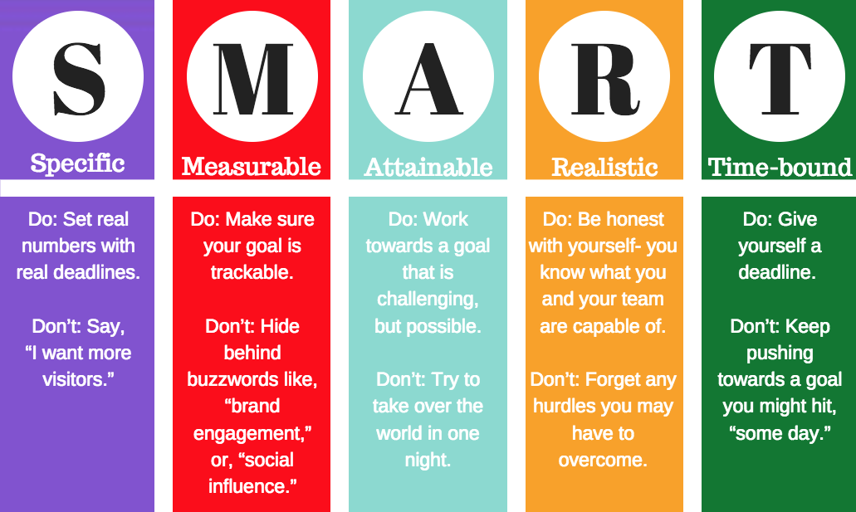

Slide 6
Journal Entry #15 Goal Setting
Begin by thinking about how to actually spend your time on a daily or weekly basis. List the activities on which you spend the most time each day (e.g., studying, working, socializing, gaming, etc). List 8+
List 2 major goals for the next 6 months, next year, next 5 years, next 20 years

Slide 7
Journal Entry continued
Please rank your first 4 activities using this scale:
1 2 3 4 5
Not true Slightly false Neutral True Very True
1 2 3 4
This activity is may choice vs others say I must do this. ___ ____ ____ ____
This activity gives me intrinsic satisfaction. ___ ____ ____ __
This activity fits my values. ___ ____ ____ ____
By doing this activity, I’m making adequate progress
toward important goals. ___ ____ ____ ____
5. I do this mostly to avoid negative consequences. ___ ____ ____ ____
6. This activity conflicts with my major goals. ___ ____ ____ ____
7. This activity helps me with my need for competence. ___ ____ ____ ____
8. This activity helps me with me need for pos. rels. ___ ____ ____ ____
9. This activity helps me with my need for autonomy. ___ ____ ____ ____

Slide 8

Journal Entry
Review the information in this chapter on how goals are related to well-being. Describe your reactions to this activity. Do your daily activities and ultimate goals match? Are you pursuing goals that research says will boost well-being? Are you using your time in a way that helps you meet important goals?

Slide 9
Goals
Affect Hypothesized to Result from Different Aspects of Pursuing Goals
 | Presence | Absence
Having Goals | Meaning, Purpose, Sense of Order | Meaninglessness, Lack of Purpose, Despair
Perceiving Goals as Attainable | Hope, Optimism, Sense of Control | Hopelessness, Pessimism, Frustration, Anger
Perceiving Progress Toward Goals | Hope, Excitement, Sense of Control, Flow | Frustration, Sense of Failure, Despair, Anger
Attainment of Goals | Satisfaction, Fulfillment | Dissatisfaction, Sense of Failure or Loss, Frustration, Anger, Envy

Slide 10

Characteristics of goals
Personal Importance:
Generally more committed to pursuing goals that are personally important (Brunstein, 1993).
Notes:
Grateful people more likely to make positive interpretations of situations and more likely to remember events more positively.

Slide 11
Characteristics of goals
Difficulty:
  Stronger positive emotions from accomplishing more challenging goals (Wiese, 2007).
  Difficult goals also appear to be more motivating, often leading to better performance (Locke & Latham, 2015).
  However, there may be a threshold where, beyond a certain point, greater goal difficulty leads to lowered motivation (Kerr & LePelley, 2013).
Notes:
Grateful people more likely to make positive interpretations of situations and more likely to remember events more positively.

Slide 12
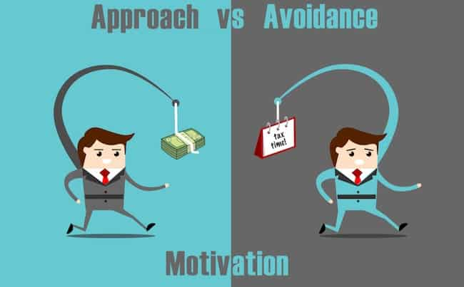
Characteristics of Goals
Approach versus Avoidance Goals:
  Approach goals involve attaining, achieving, or increasing something.
  Avoidance goals involve avoiding, stopping, or reducing something.
  People who habitually frame goals in approach-oriented ways tend to be more successful at achieving them than those who frame goals in avoidance-oriented ways (Higgens, 1997).

Slide 13

Characteristics of Goals
Specific versus Abstract Goals:
  The more specific goals are, the more they “detail specific, tangible rewards achieved by particular behaviors in response to particular contexts” (Fujita & MacGregor, 2012, p. 86).
  The more abstract goals are, the more they reflect “general aims that transcend specific situations” (p. 86).
  Overall, research shows that people tend to perform better when their goals are more specific (Sheeran & Webb, 2012), and thus experience greater emotional well-being.

Slide 14
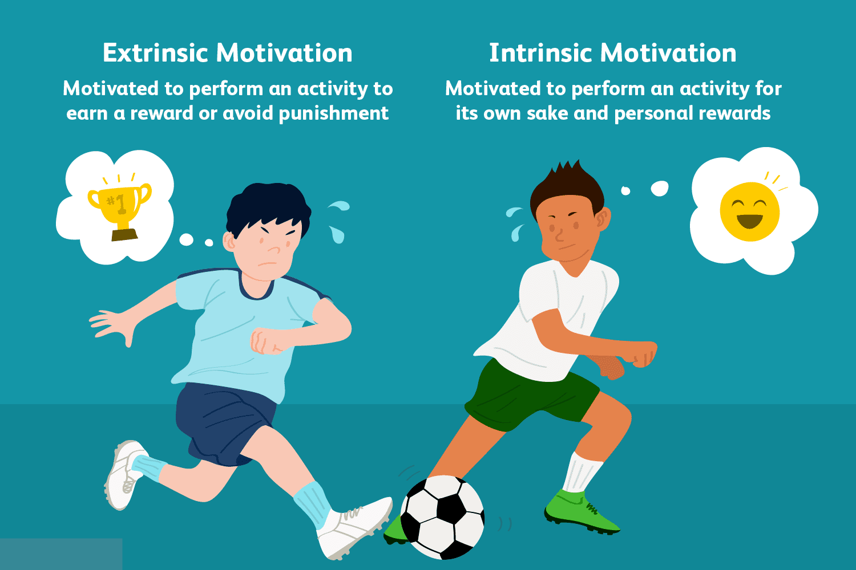
Characteristics of goals
Intrinsic versus Extrinsic Goals:
  Intrinsic goals: Also known as self-concordant goals, these satisfy our deepest needs and values, often including personal growth and interpersonal closeness.
  Extrinsic goals: Goals that primarily lead to external rewards and approval like wealth, status, or fame.
  In general, people with greater numbers of intrinsic goals tend to experience higher levels of psychological well-being than those with greater numbers of extrinsic goals and are more motivated to achieve their goals (e.g., Kassar & Ryan, 2001; Koestner et al., 2002).
Notes:
Grateful people more likely to make positive interpretations of situations and more likely to remember events more positively.

Slide 15

Optimism:
Learned and
Dispositional

Slide 16

Dispositional Optimism

Slide 17
Dispositional optimism
Dispositional optimism: The tendency to believe that outcomes in one’s life will be positive, favorable, or desirable.
  A generalized outlook, not tied to any single area of life or set of goals.
  As the term “dispositional” suggests, optimism functions like a personality trait, with levels staying relatively stable over time.

Slide 18
Measuring dispositional optimism
Life Orientation Test (LOT)
  Self-report scale developed by Sheier and Carver (1985).
  Initial version was later revised due to criticisms that it contained items seemingly measuring the degree to which people were emotionally stable rather than strictly optimistic.
  The new scale, the LOT-R (for “revised”), contains 10 items, including, “Overall, I expect more good things to happen to me than bad” (p. 1073; Sheier, Carver, & Bridges, 1994).
  Respondents indicate the degree to which they agree with each item on a 5-point scale.

Slide 19
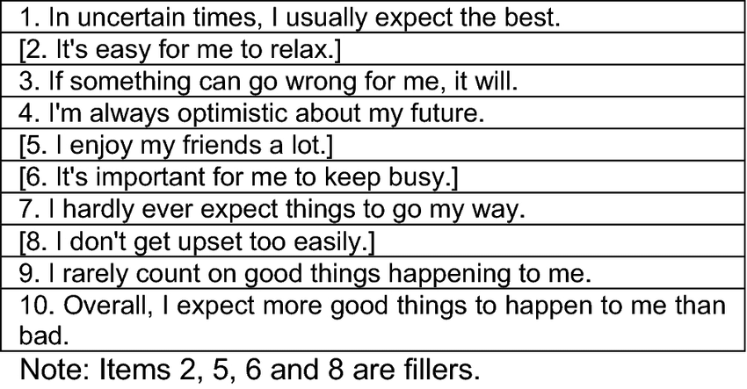
LOT-R

Slide 20
Dispositional Optimism Research
Coping with distress
  Optimism consistently linked to lower levels of personal distress, pessimism to higher levels of distress
Coping with life transitions
  Having 1st child
    Optimism may offer resistance to post-partum depression
  Coronary bypass surgery
    Optimists reported less presurgical distress, more confidence in and satisfaction with their medical care, more relief and happiness shortly after surgery, and greater post-surgery lift satisfaction
  HS to College

Slide 21
Coping with HS to College Transition
Aspinwall and Taylor (1992) examined 3 individual differences as predictors of successful adaptation
Self-esteem, perceived control, and optimism
At beginning of second semester, college students completed 4 measures related to college adjustment, responding to items addressing their levels of stress, their happiness, and their general well-being
Optimism had a direct and independent positive effect
Continued…

Slide 22
Coping with HS to College Transition
Perceived control and self-esteem were more indirect and depended on their relation to active rather than avoidant coping with college success
  High self-esteem and personal control improved adjustment only if students also actively sought solutions and help for adjustment problems
  If they avoided rather than confronted their problems, the benefits of self-esteem and presonal control were diminished

Slide 23

Learned Optimism

Slide 24
Learned Optimism
A different perspective on optimism, developed by Martin Seligman separately from dispositional optimism.
According to Seligman’s (2006) research, people habitually explain the causes of events along three dimensions:
stable vs. temporary (aka permanence)
global vs. situation-specific (aka pervasiveness)
internal vs. external (aka personalization)

Slide 25
What would you do?
Imagine that you went to the bank and an armed bank robber came into the bank. The gun is fired and you suffer a minor injury when the bullet grazes your skin. No one else is harmed and the bank robber is arrested. How do you explain this event to family and friends?

Slide 26
Learned optimism
When positive or negative events occur, people who exemplify learned optimism vs. learned helplessness (aka, pessimism) attribute these events differently.
 | Positive Events | Negative Events
Optimists | Internal Stable Global | External Temporary Specific to the Situation
Pessimists | External Temporary Specific to the Situation | Internal Stable Global

Slide 27

Measuring learned optimism
Seligman and his colleagues developed the Attributional Style Questionnaire (ASQ) to measure people’s explanatory styles.
  Contains brief descriptions of six positive and six negative events (e.g. “You run for a community office position and you win”).
  After each, respondents write down what they believe was the cause of the event and rate that cause on the three attributional dimensions.

Slide 28
What is Optimism?
Commonsense View
  “the glass is half full”
  “see the silver lining…”
  Expecting to see a Hollywood ending to real troubles
  Positive thinking angle: repeat boosterish phrases to ourselves (e.g., “I’m getting better and better” or visualize success)
  These are all manifestations of optimism…optimism is deeper
What is fundamental to optimism lies in the way we think about causes, our explanatory style
Explanatory style develops in childhood, and without explicit intervention, is lifelong
Seligman, The Optimistic Child

Slide 29
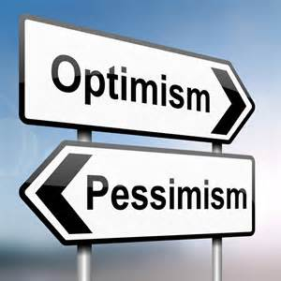
Childhood Antecedents of Learned Optimism
Partly genetic
  Monozygotic twins r = .48
  Dizygotic twins r = .00
Partly learned
  Parents provided safe, coherent environments
  Parents modeled optimism
    Made explanations for negative events
    Provided explanations for positive events
    Had parents who understood failures and attributed them to external causes (adaptive excusing)

Slide 30

The Right Way to Criticize
Be accurate with blame when criticizing self (because of modeling) and child
“You are so lazy” makes child believe he is lazy and it is permanent and unchangeable
When appropriate, criticize with an optimistic explanatory style
When child is at fault, focus on specific and temporary personal causes, and avoid blaming the child’s character or ability

Slide 31
Criticizing a Preschool Child
Permanent (Pessimistic)
“Tammy, what’s wrong with you? You are always such a monster!”
“Wendy said you cried the whole time I was out. You’re such a sensitive child.”
“Cory, I asked you to pick up your toys. Why don’t you ever do what I ask?”
Changeable (Optimistic)
“Tammy, you are really misbehaving today. I don’t like it at all.”
“Wendy said you cried the whole time I was out. You’ve been having a hard time being away from me lately.”
“Cory, I asked you to pick up your toys. Why didn’t you do what I asked?”
Seligman, The Optimistic Child

Slide 32
Criticizing a Preschool Child
Global (Pessimistic)
“You are a bad boy.”
“That’s OK Tanya. You’ve got your mom’s knack when it comes to sports. I’m horrible at sports too.”
“She never likes to play with the other kids. She’s so shy.”
Specific (Optimistic)
“You tease your sister too much.”
That’s OK Tanya. You’ve got to learn to keep your eye on the ball.
“She has a hard time joining groups of kids.”
Seligman, The Optimistic Child

Slide 33
Criticizing a Preschool Child
Internal and General (Passive)
“You’re not athletic.”
“You kids are so selfish.”
“Another C-?! I guess you just aren’t an A student.”
“This room is a pig sty! You are such a slob!”
Internal and Behavioral (Active)
“You have to work harder on watching the ball meet the bat.”
“You kids must share more.”
“Another C-?! You need to spend more time on your studies.”
“This room is a pig sty! You need to start picking up after yourself.”
Seligman, The Optimistic Child

Slide 34

Increasing Optimism
If someone falsely accuses us, we dispute with them, but when we have pessimistic thoughts, rarely do we dispute them.
First thing: recognize pessimistic thought
Second: dispute with ABCDE model

Slide 35
ABCDE Model for Pessimistic Thoughts
A Adversity
B Beliefs
C Usual consequences
D Disputation of your routine belief
E Energization that occurs when dispute successfully

Slide 36
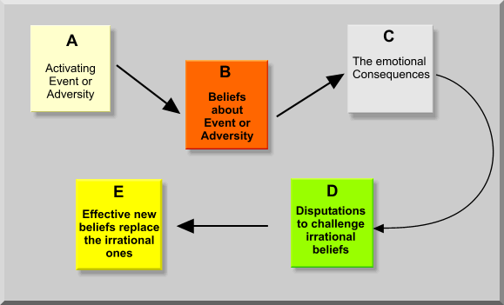
ABCDE Model

Slide 37

Disputations
Disputations involve checking out the accuracy of the beliefs about ourselves that are encouraging us to feel pessimistic

Slide 38

4 ways to make disputations convincing
Evidence
  Show negative belief is factually incorrect
  Most negative beliefs are overreactions
  E.g., “worst in class”…ask other students about their grade
Alternatives
  Ask yourself if there are alternative ways to look at the problem which are less damaging to yourself, and focus on causes that are changeable
  Scan for all possible contributing causes (pessimists latch on to worst of all these causes, usually permanent and pervasive one)
  Focus on causes that are changeable, specific, and nonpersonal

Slide 39

4 ways to make disputations convincing
3) Implications
  Negative belief may be true…so, decatastrophize.
  E.g., I’m factual and straightforward. What’s the implication? Doesn’t mean I won’t have any friends.
4) Usefulness:
  Is belief destructive? How can you change situation in future?

Slide 40
Journal Entry #16:
Explanatory Style
We can all think in more optimistic ways. Take a moment and recall a recent setback or disappointment in your life. Start with something that feels relatively small and safe. Now ask yourself the following 3 questions to assess your explanatory style.
  Who or what was to blame?
  How long will the causes and/or the fallout of this event last?
  How much of my life will this affect?
  Now, which explanatory style is represented with this example? Is this representative of how you usually think about things?

Slide 41
The more you believe that event was your fault (ques 1), will never go away (ques 2) or will affect most or all areas of your life (ques 3), the more you’re explaining this event in a pessimistic way.
  If this is the case, see if you can revisit the questions above and look for other possible explanations. Ask yourself if you really are completely to blame. Consider any situational factors and influences, including bad luck, that may have played a role in causing the event. Likewise, gently question your assumption about how long-lived the negative event’s effects are likely to be. When we experience strong emotions, we can confuse how bad somethings feels at the moment with how long it will actually last. Finally, look for areas of your life that remain stable and relatively unaffected by the negative event.

Slide 42
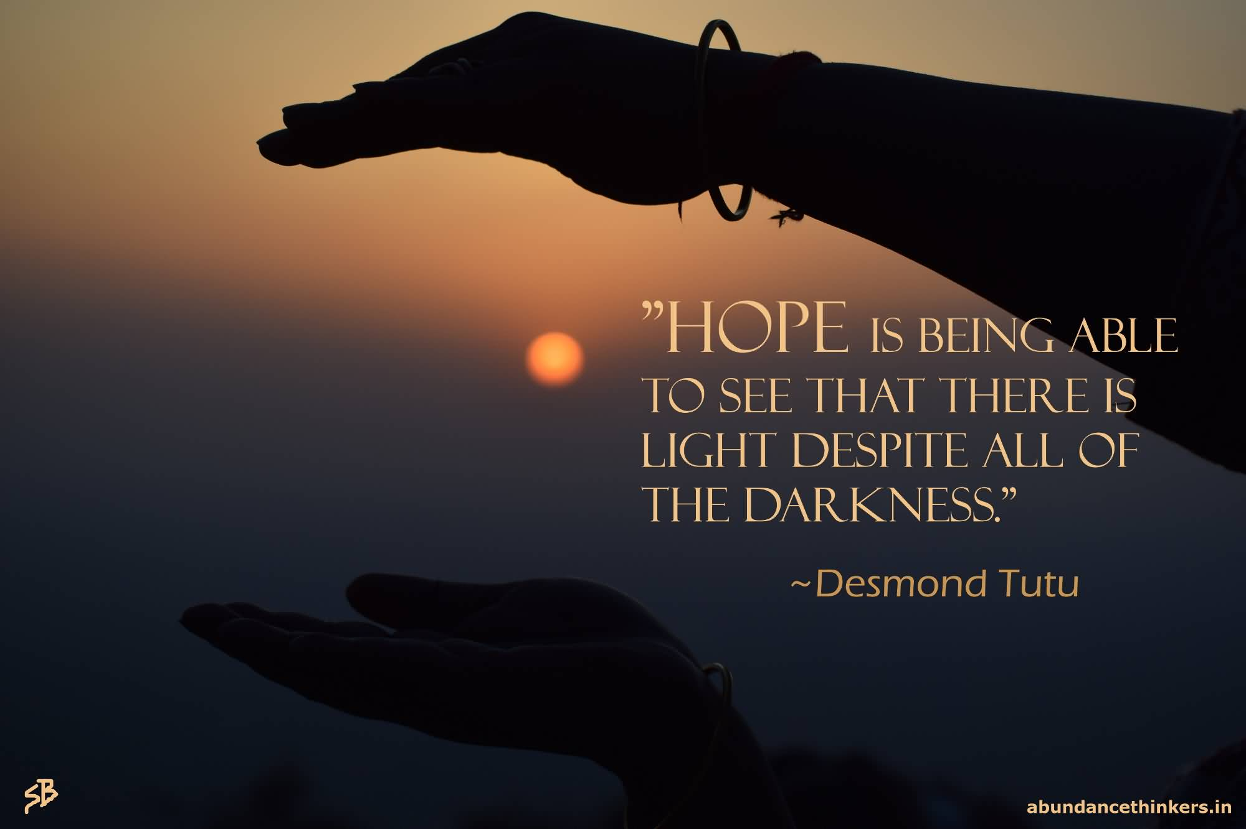
Hope

Slide 43
Hope
Hope Theory is a model of hope developed by C. R. Snyder (1994).
According to this model, hope has three components:
  Goals: Anything that people want to get, do, be, accomplish, or experience.
  Pathways: Plans or strategies people believe will lead to goals.
  Agency: The collection of beliefs that motivate people to work toward achieving their goals.
Pathways and agency are theorized to influence one another, so that a change in one will correspondingly alter the other (Snyder, 2002).

Slide 44

Measuring Hope
Several valid and reliable measures have been developed to assess hope, including:
  The Hope Scale, which measures hope in a trait-like way
  The State Hope Scale, which measures one’s momentary, or “state” level of hope

Slide 45
Hope, optimism, and well-being
Psychological Health and Well-being:
  Greater hope and optimism are associated with lower depression and anxiety, as well as higher self-esteem and meaning in life (e.g., Feldman & Snyder, 2005).
  People with higher hope and optimism also tend to follow through on their goals and experience greater goal accomplishment than people with lower levels of these constructs.
Physical Health and Well-being:
  Higher hope and optimism are associated with health-promoting behaviors (e.g., being a non-smoker, regular exercise).
  People with higher optimism and hope also appear to cope better with pain and may perceive painful stimuli as less painful than people with lower levels of these constructs (Sheier & Carver, 1992; Snyder et al., 2005).
Given Hope Theory’s emphasis on pathways (planning) and agency (motivation), some researchers suggest that hope may be a somewhat stronger predictor of achievement and well-being in controllable situations (Rand, Martin, & Shea, 2011).

Slide 46
Unrealistic optimism
(aka, optimism bias)
Study: Weinstein (1980) listed 24 negative events ranging from relatively small (your car turns out to be a lemon) to catastrophic (developing cancer), and asked college students to estimate their risk for each. For nearly all the events, most students indicated they were at lower risk than other students at their school of the same age and gender. Statistically, this is impossible.
May lead people to take unnecessary risks, believing they are less vulnerable than they really are.
Not easy to change.

Slide 47
Culture and positive expectancies
Although hope and optimism likely cut across cultures, this doesn’t mean everyone thinks about and uses these assets in identical ways. For instance, goals exist within cultural contexts.
Study: Shigehiro Oishi and Ed Diener (2001) compared the goals of White American college students with Asian American college students.
  In a series of studies, they asked students to write down goals they planned to pursue during the next month and rate each on the degree to which it was independent and interdependent.
  A month later, participants reported how much progress they had made toward these goals and completed a life satisfaction survey.
  The results revealed a cultural difference: The more progress the White students had made toward achieving independent goals (those to achieve fun and enjoyment for themselves), the more satisfied they felt about their lives. In contrast, among the Asian American students, making progress on independent goals wasn’t related to life satisfaction at all. For them, more progress on interdependent goals (those to benefit family or friends), was related to greater life satisfaction.

Slide 48
Culture and positive expectancies
Positive expectancies may have different effects in groups facing high societal barriers.
This is perhaps most apparent in research on the psychological phenomenon known as John Henryism, the tendency to respond actively to stressors with the expectation that determination and hard work will lead to success. (Named for 19th century African American folk hero, John Henry.)
Studies show that people with high levels of John Henryism, but who also have few financial resources and face high societal barriers, have increased risk of cardiovascular problems and generally diminished physical health (Brody, Yu, Miller, Ehrlich, & Chen, 2018; Mujahid, James, Kaplan, & Salonen, 2017).
Black Americans, facing discrimination and significant structural barriers, are particularly vulnerable to this set of circumstances (Bennett et al., 2004).

